Slide 1

WSO2 API Manager 4.2.0 Developer Advanced
Key Management
WSO2 Training

Slide 2
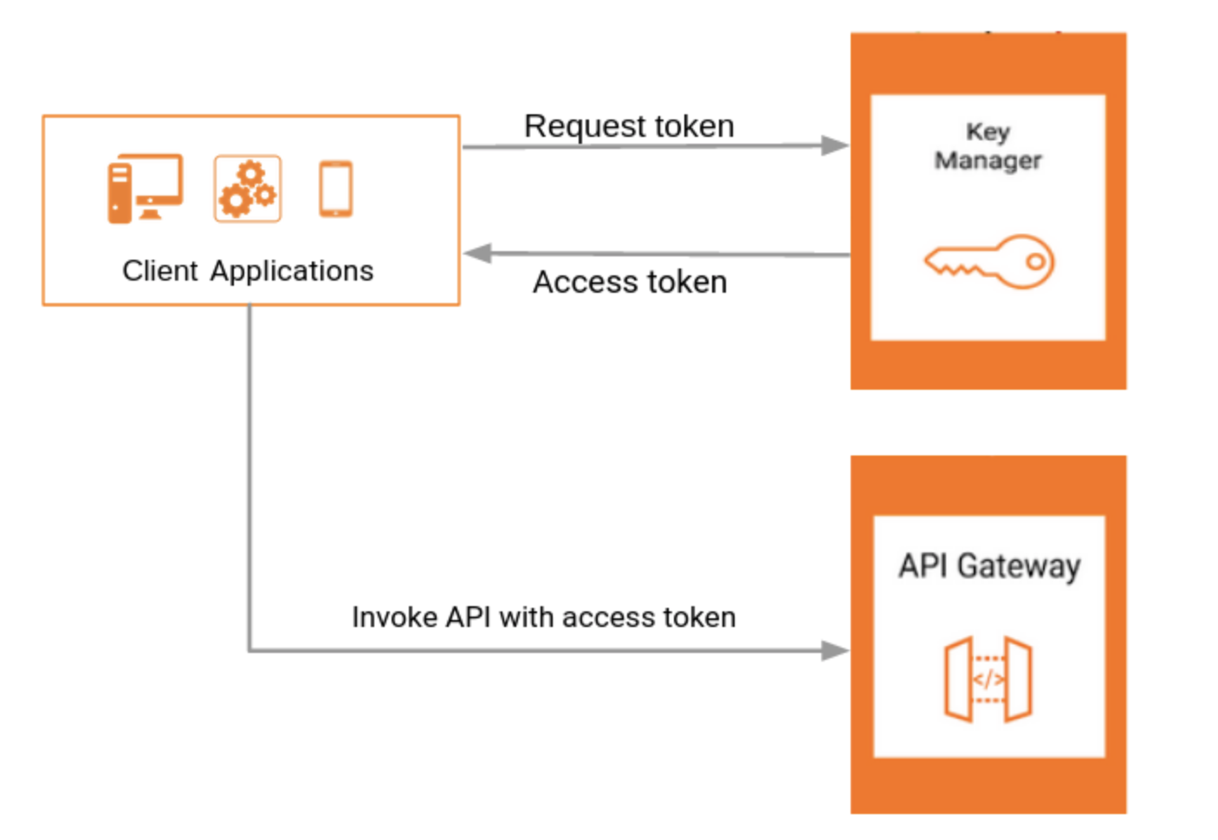
Key Manager Overview
Key Manager

Slide 3
Key Manager
The Key Manager handles all clients, security and access token-related operations.
A subscriber can generate a consumer key and a consumer secret once an application is created. In the above scenario, the API Developer Portal will direct the call to the Key Manager.
When a subscriber generates an access token to the application using the API Developer Portal, the Developer Portal makes a call to the Key Manager to create an OAuth App and obtain an access token.
In a typical production environment, you can configure one of the following setups:
Configure a WSO2 API Manager instance as the Key Manager.
Configure an instance of WSO2 Identity Server as the Key Manager.
Configure a third-party authorization server such as Okta, KeyCloak, Auth0, PingFederate, ForgeRock for key validations.

Slide 4
Token Generation Flow
POST /oauth2/token
Headers:
Content-Type: application/x-www-form-urlencoded
Authorization: Basic Base64Encoded(consumer-key:consumer-secret)
Payload: grant_type,scopes,username,password
Key Manager
Application
oauth2.war
:9443/oauth2/token
{
"access_token": "eyJ0eXAiOiJKV1QiLCJhbGc...FuTpDS0esJUn4-LKm-OSbVS28ldTg"
"scope":"default", "refresh_token":"ab8d449a-5e29-3643-bc19-8c76f984eff2"
"token_type":"Bearer",
"expires_in":3600
}

Slide 5
Validating the Token Request
Grant handler is selected for the requested grant type in the token request.
identity.xml/Server/OAuth/SupportedGrantTypes
The selected grant handler performs few actions
isAuthorizedClient() - Are the client ID and secret valid?
validateGrant() - Are the specific parameters valid for the grant type?
validateScope() - What are the eligible scopes for the user?

Slide 6
Token Revocation
Client sends the revocation request to key manager (/revoke)
Key Manager revokes the token, persists the token information and sends the OK response.
Gateway responds back to the client.
Key Manager publishes the revoked token information to the Control Plane event API.
Gateway nodes that are subscribed to the Control Plane are notified.
Gateways clears the caches related to the revoked token.
Notes:
When using JWTs, Gateway does not communicate with Key Manager to validate the token.
Upon revocation of a JWT, Gateway keeps an in-memory map of revoked token signatures.
When an API is invoked with a JWT, Gateway looks for the revoked token map for matching signatures.
If a matching signature is found, the unauthenticated response is sent to the client.
If the gateway is restarted, gateway fetches the revoked tokens from the Key Manager and populates the revoked token map.

Slide 7
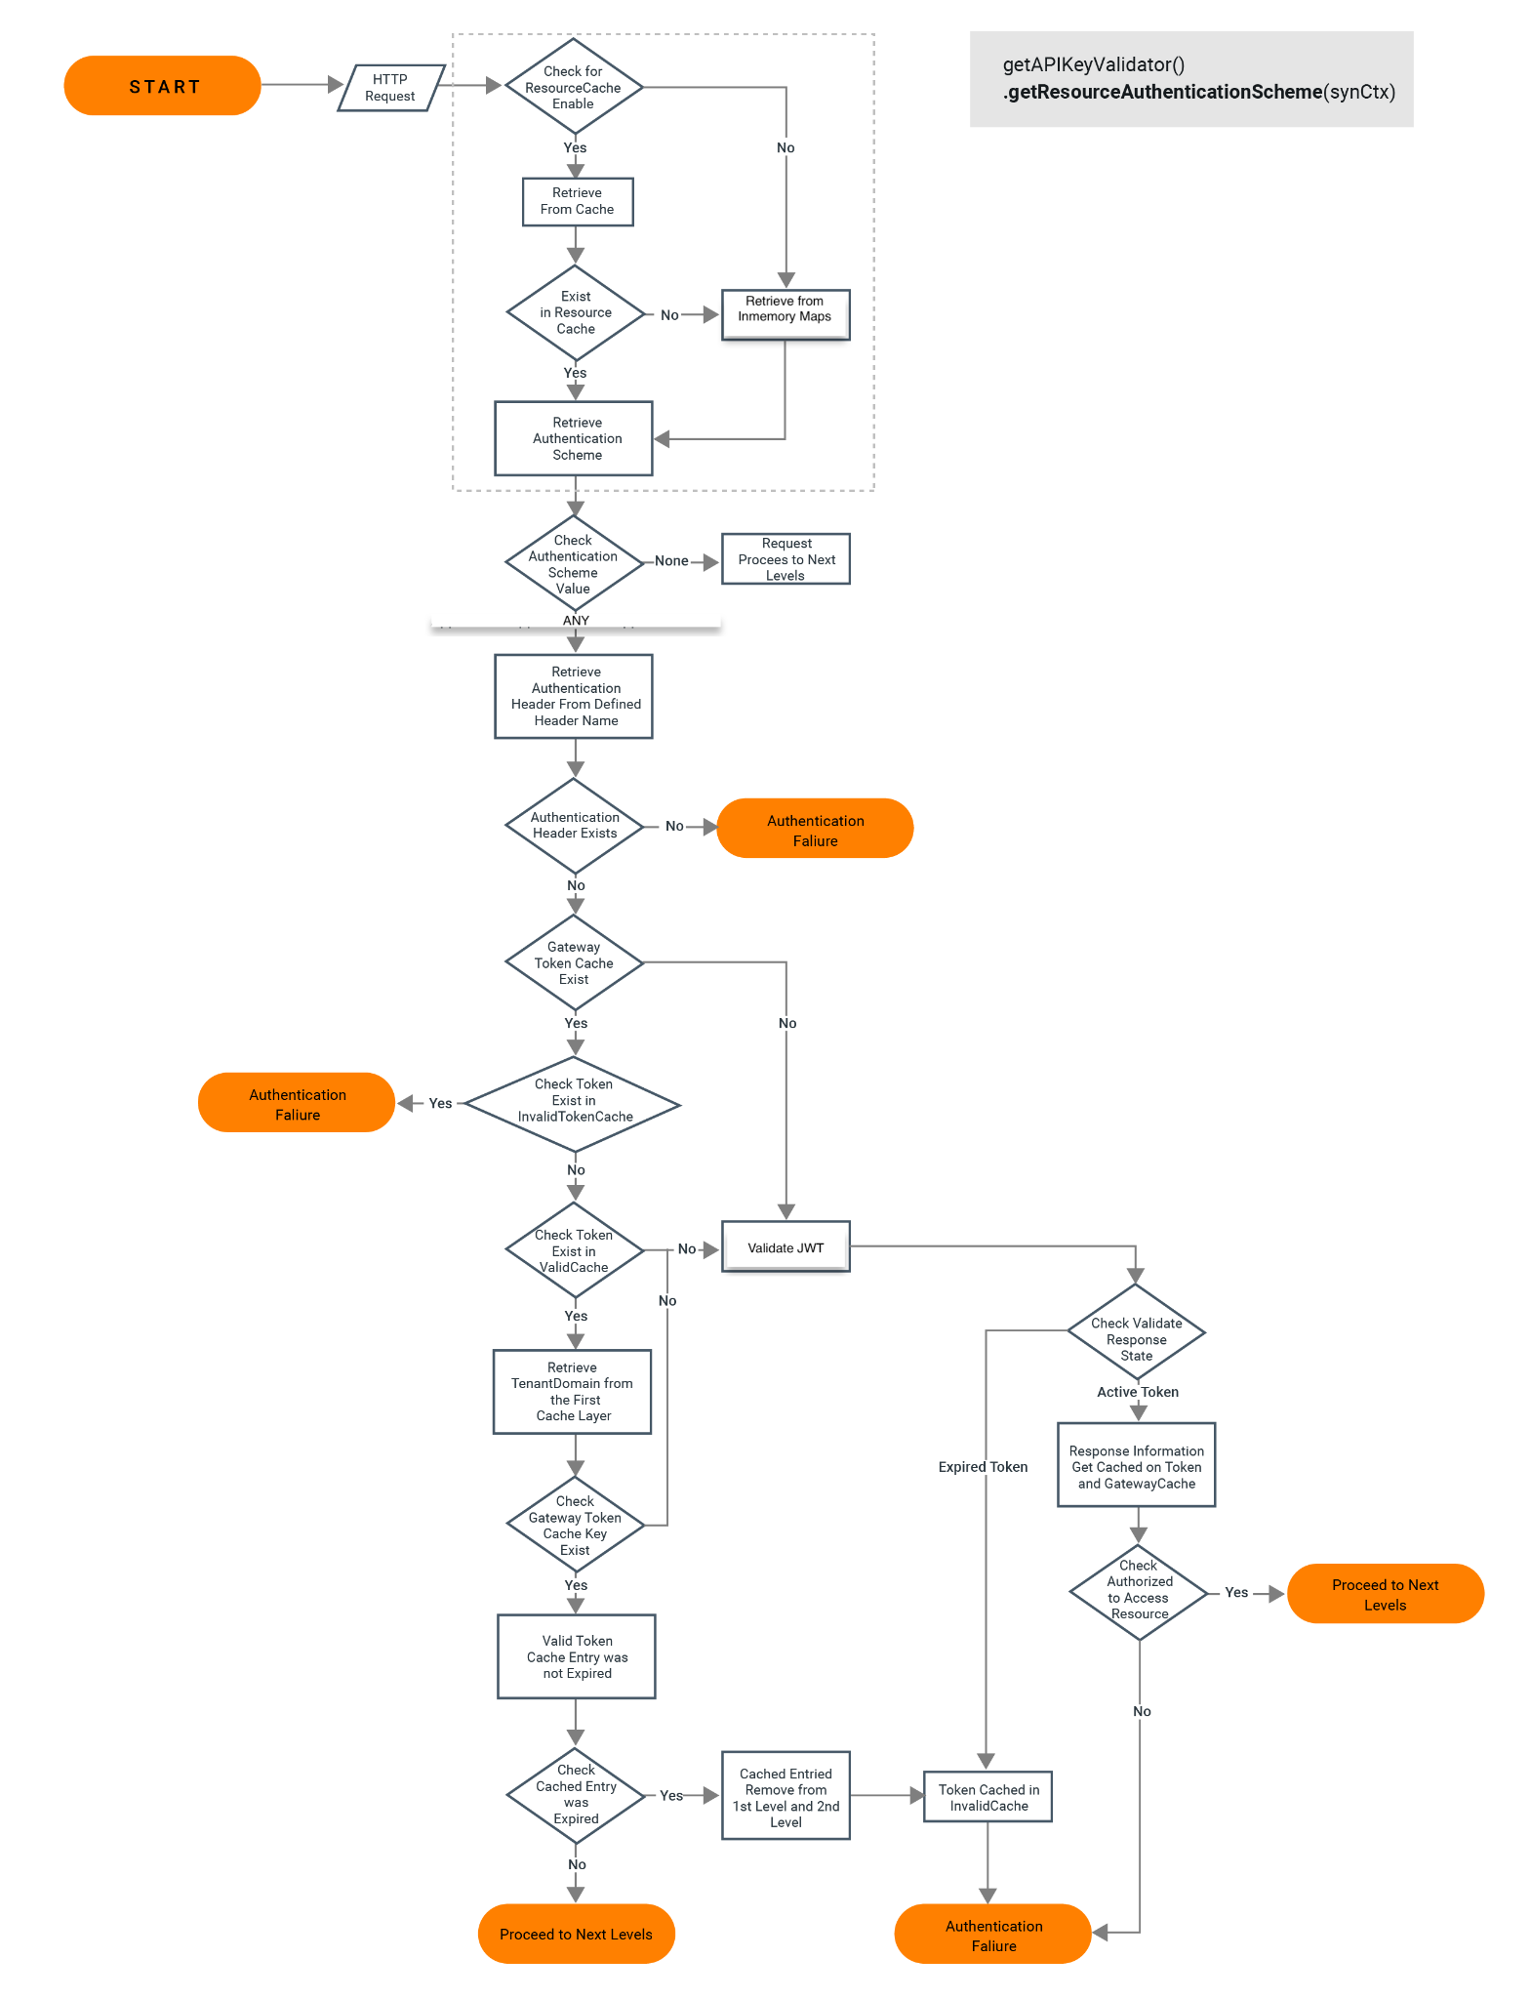
OAuth Authentication in Gateway

Slide 8
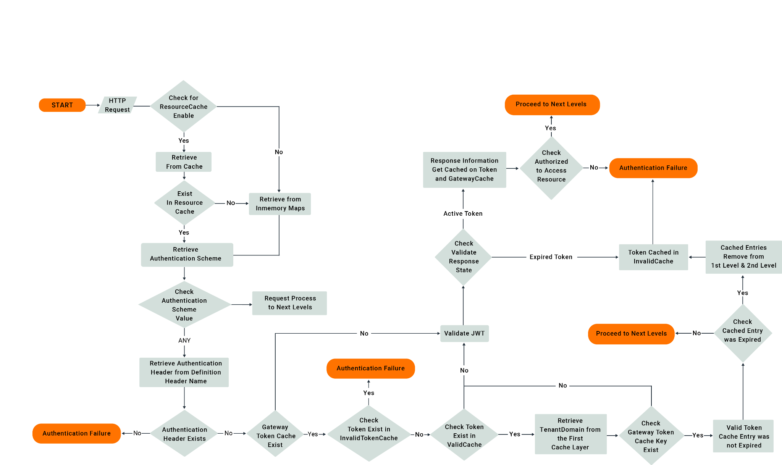

OAuth Authentication in Gateway

Slide 9






Configuring a Third Party Key Manager
Configure WSO2 Identity Server as Key Manager Configure Okta as a Third Party Key Manager
Configure Keycloak as a Third Party Key Manager
Configure Auth0 as a Third Party Key Manager
Configure PingFederate as a Third Party Key Manager
Configure ForgeRock as a Third Party Key Manager

Slide 10
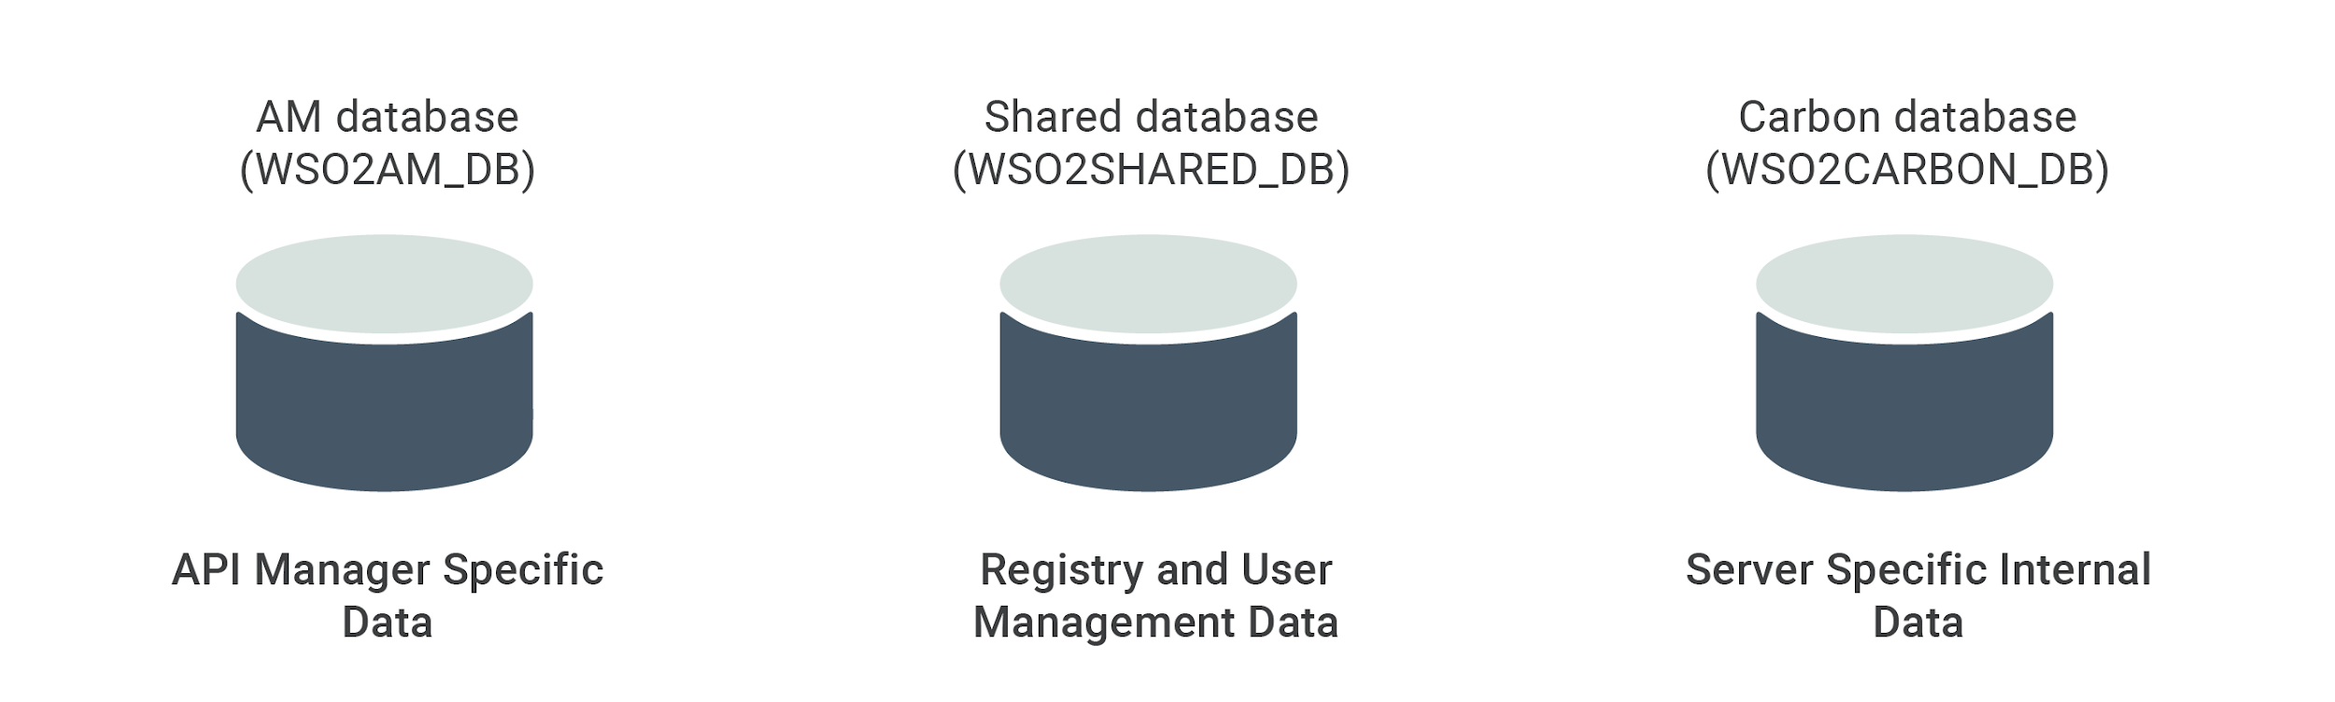
Sharing databases
Set up WSO2 Identity Server as Key Manager

Slide 11
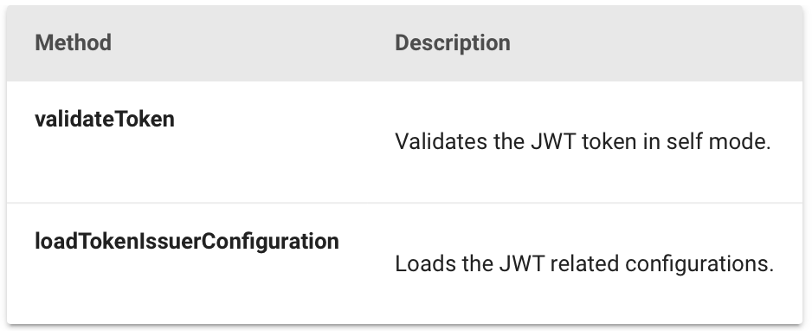
Key Validation
Extending JWT Validator Interface
Extending Key Validation

Slide 12
Key Validation
The default token type in API-M 4.2.0 has been set to JWT (JSON Web Token)
In API-M 4.2.0 the Key Manager call to runtime for key validation process has been removed altogether.
The JWT Token validation takes place at the Gateway itself and the subsequent subscription validation also takes place in the Gateway as the required meta-information is available in the Gateway memory.
JWT Token validation occurs via the JWTValidator interface.

Slide 13
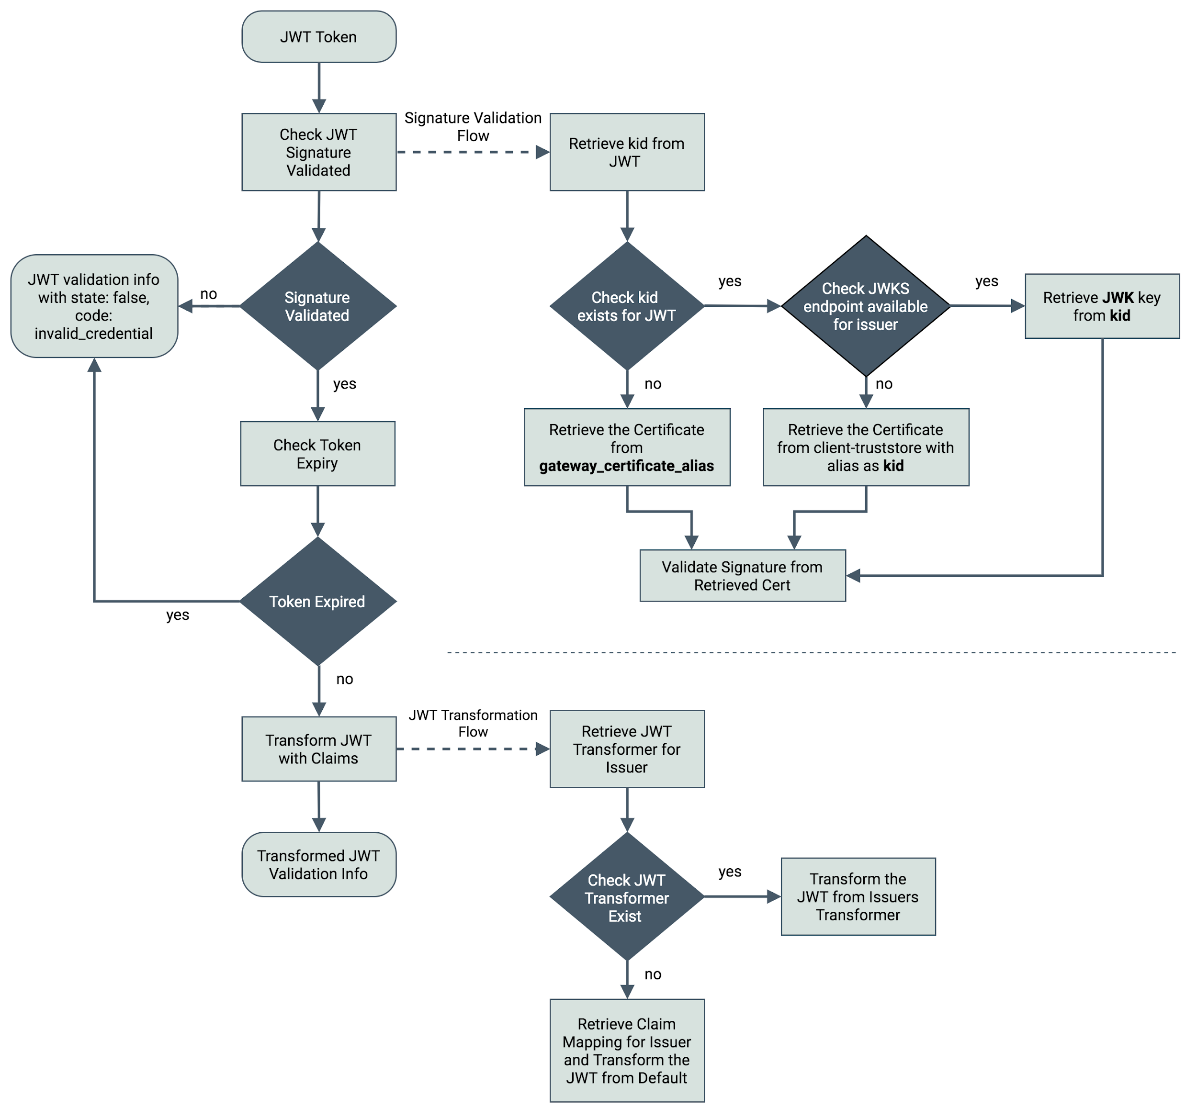
Validating the Token at Gateway

Slide 14
Scope Validation
OAuth scopes allow you to have fine-grained access control to API resources based on the user roles.
API Manager uses scopes as a way of defining permissions for a resource.
Validating the role of a requester does not make much sense in some scenarios. For instance, when the scope is used as a means of generating an access token and not for securing a resource (e.g. OpenID scope). In such situations, scope validation can be extended to skip role validation for certain scopes.
Notes:
It allows you to define scopes per API and associate defined scopes with API resources. OAuth 2.0 bearer tokens are obtained for a set of requested scopes and the token obtained is not allowed to access any API resources beyond the associated scopes.
If a resource is assigned a scope, then the token accessing the resource should be generated with that scope. By associating a scope with a role, you can control which users are permitted to have tokens under certain scopes. In this instance, associating a role to a scope seems legitimate.

Slide 15
Extending Scope Validation
When scopes that cannot be associated to roles are requested, the token should be issued without validating the scope.
In WSO2 API Manager, you do this by allowing the scope through a configuration.
Scopes that match the pattern are not validated by role and are available to anyone requesting it.
[apim.oauth_config]
allowed_scopes = ["^device_.*", "openid", "some_random_scope"]
Extending Scope Validation

Slide 16
Extending Key Manager Interface
Key Manager interface acts as the bridge between the OAuth Provider and WSO2 API Manager.
In order to plug an external OAuth2 Authorization server as the Key Manager for API-M you should implement a third-party Key Manager Connector by extending the Key Manager Interface.
Link - Configure a Custom Key Manager

Slide 17

WSO2 Identity Server as the Key Manager
Let’s try it out!

